Slide 1
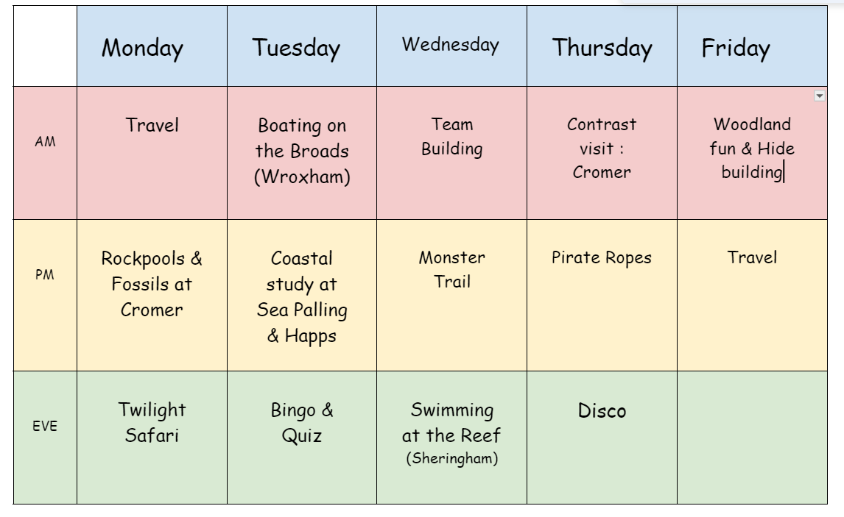
Our 2024 itinerary as an example:
Notes:
Mark – itinerary

Slide 2
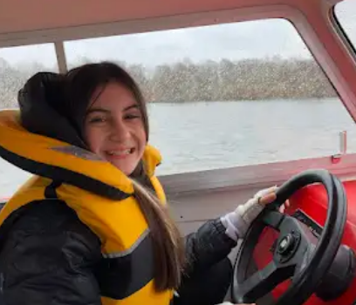
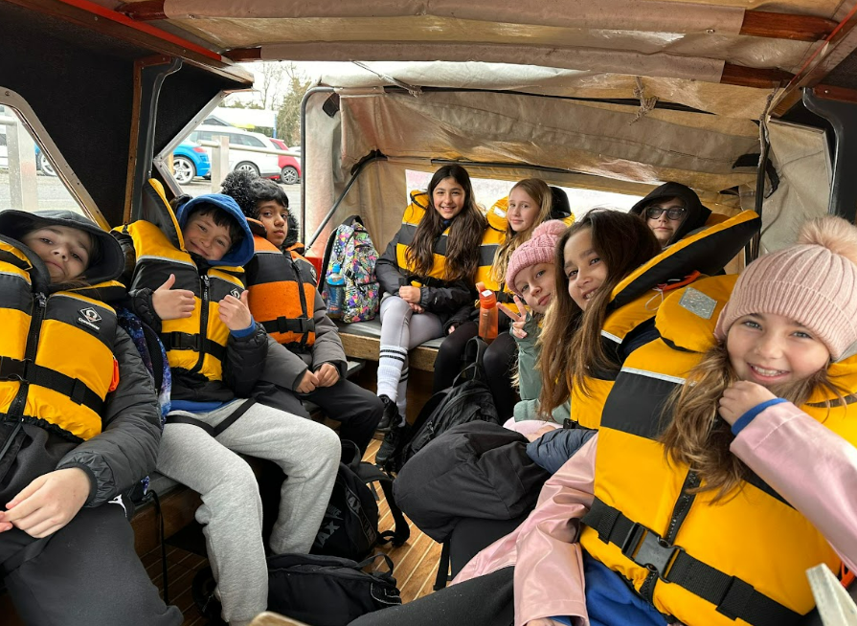
Boating at Wroxham
Cruising the waterways of the Norfolk Broads

Slide 3
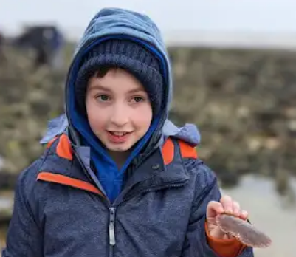
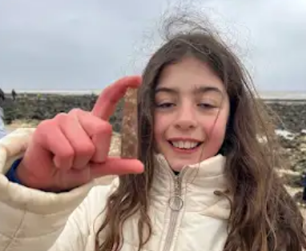
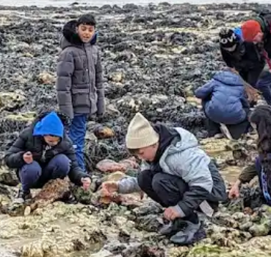
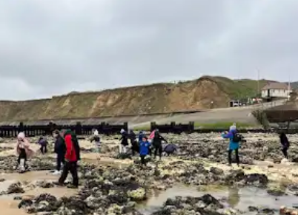
West Runton – Rock Pooling
Investigating the creatures
and plant life that live in the
rock pools

Slide 4
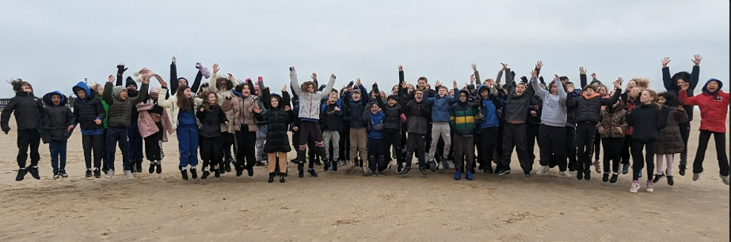
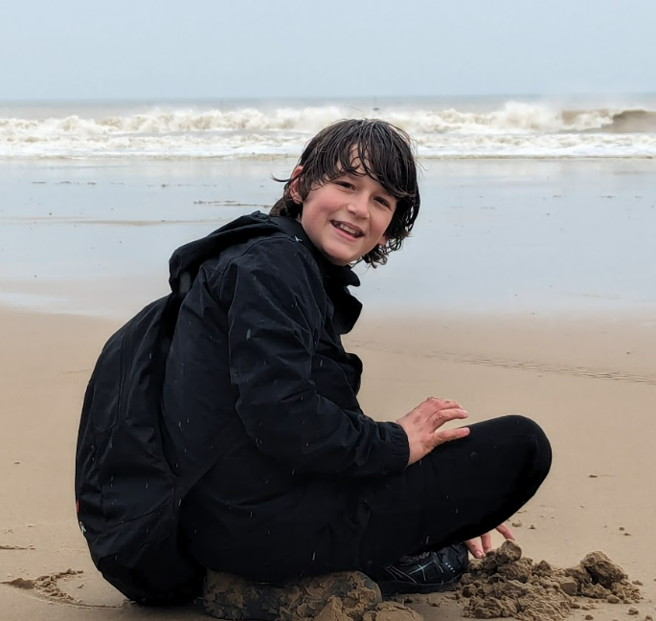

West
Runton
‘Beach Walk’ to Cromer

Slide 5
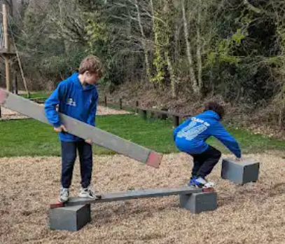
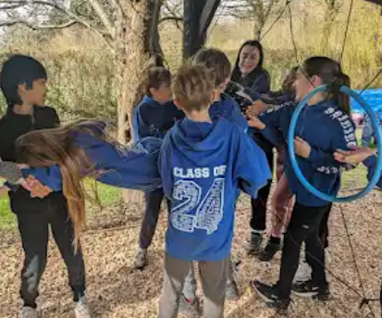
Monster Day – Team Building

Slide 6
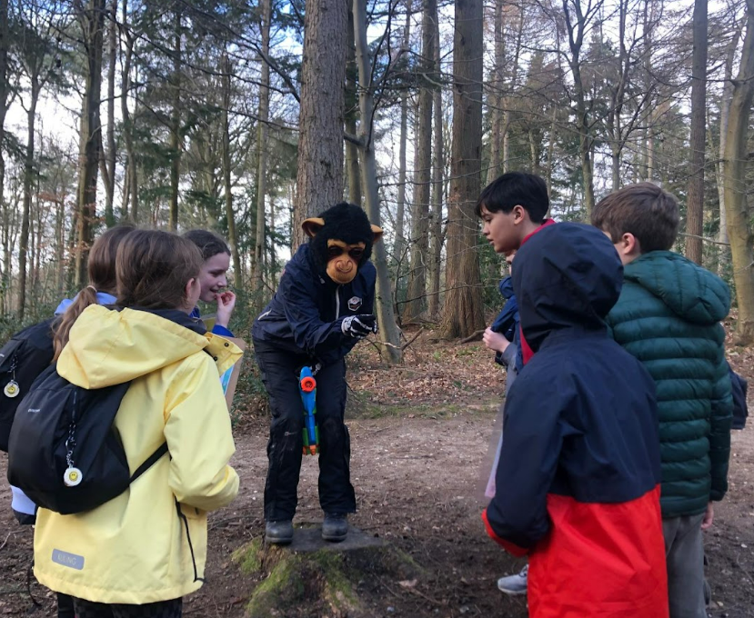
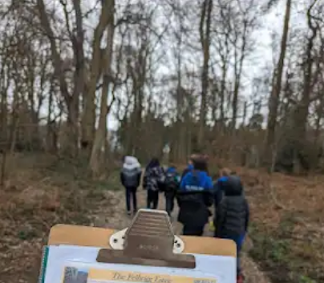
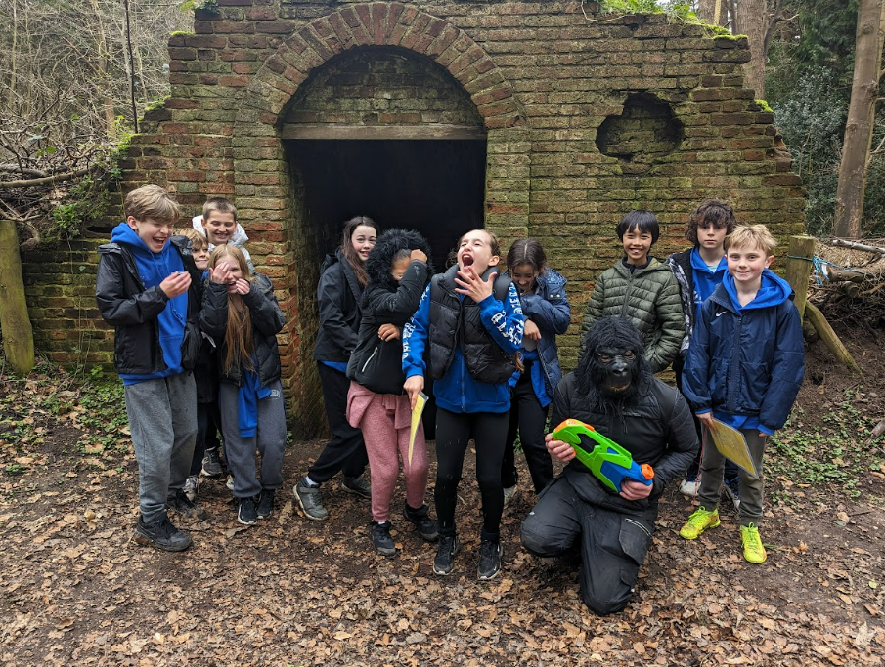
Monster Day – Monster Trail
Children master map
reading and use of
a compass

Slide 7
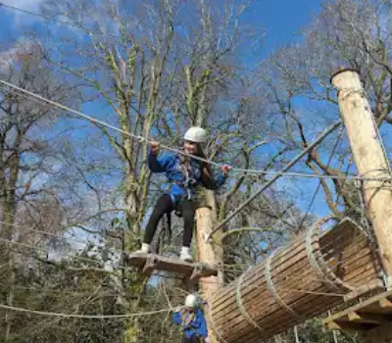
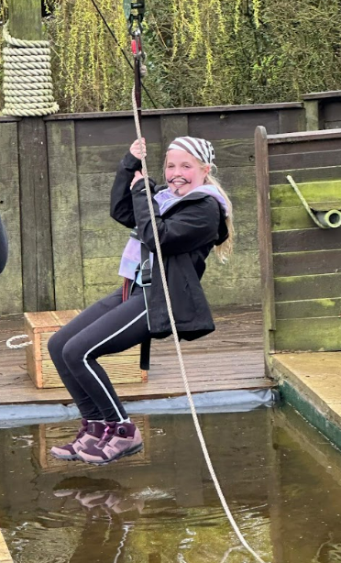
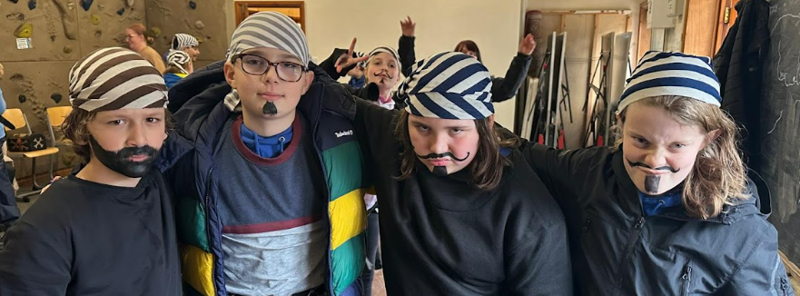
Pirate Day
Dress up and train to be a pirate

Slide 8
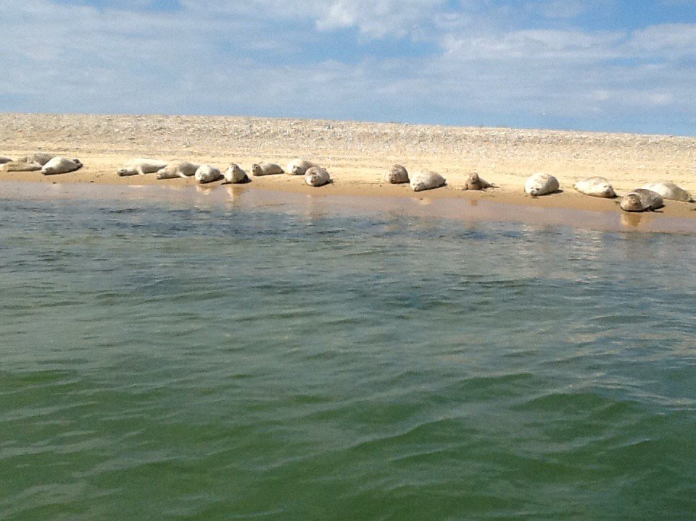
Seals
Blakeney Point – A National Trust nature reserve

Slide 9
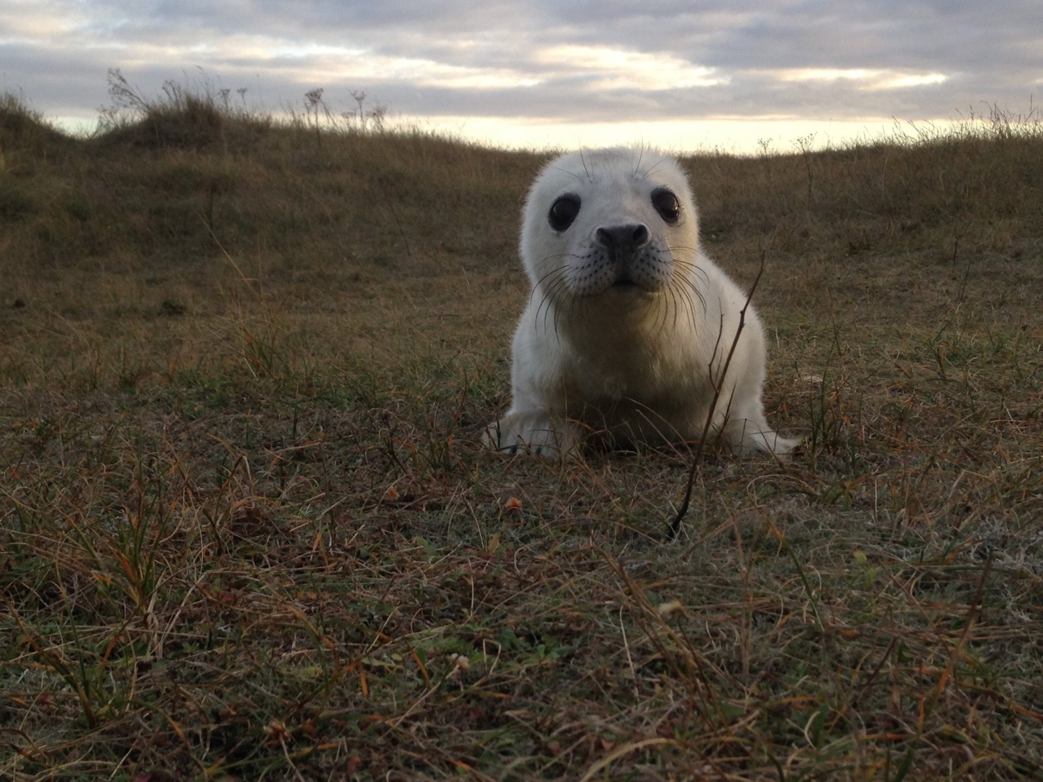
Seals
One of the babies

Slide 10
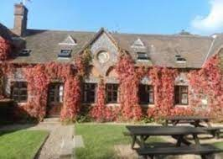
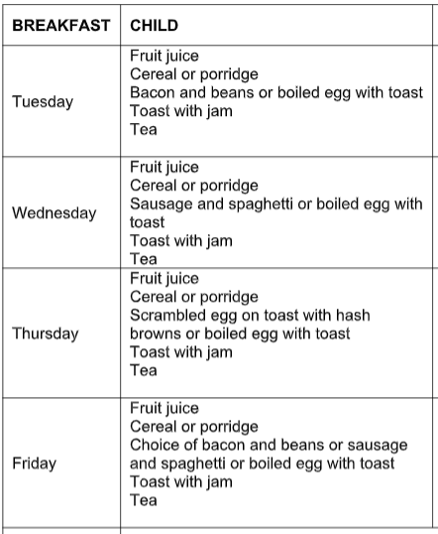
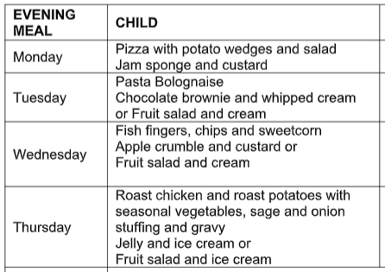
Food – breakfast, lunch & dinner
Packed lunch needed on Day 1
Notes:
Hannah – food

Slide 11
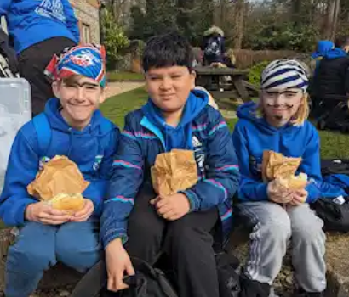
FAQs – Will my child have enough to eat?
Medical dietary requirements are catered for
(e.g. gluten free, lactose free etc)
We provide vegetarian options

Slide 12
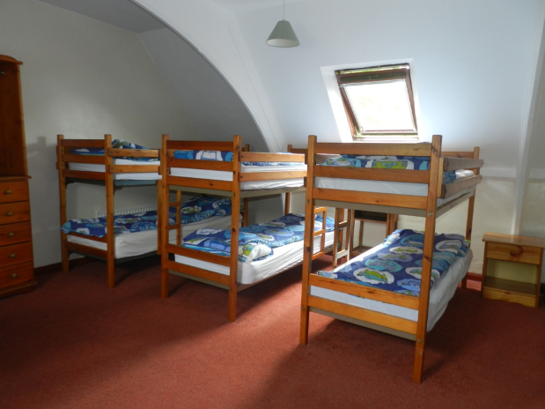
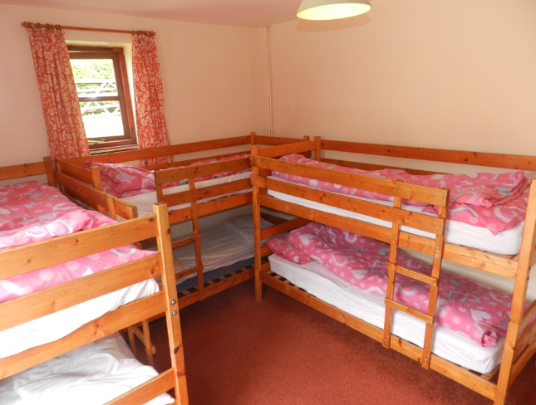
Accommodation
Bunk bed dormitories
Central heating
Showers and toilets
SRS staff rooms interspersed
No other schools or visitors on site
Notes:
Hannah - accommodation

Slide 13
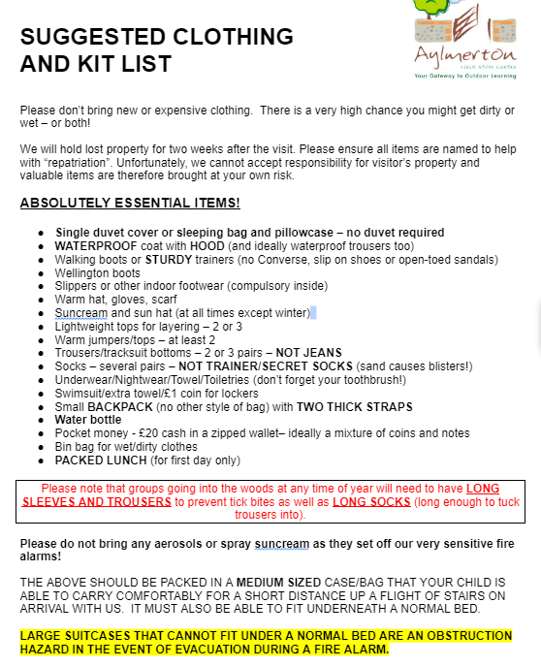
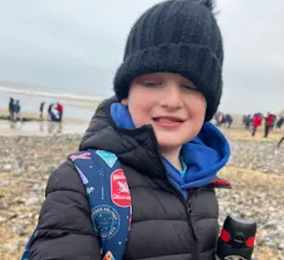
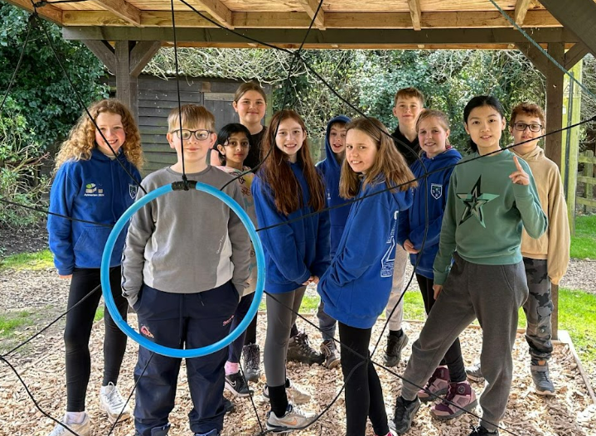
Kit - start planning ahead
Notes:
April – kit list

Slide 14
FAQs – key items
Comfortable, worn-in walking boots/shoes or sturdy trainers (not canvas
Converse or similar style pumps)
Long wellington boots (any time of year if it has rained)
Slippers or other indoor footwear (compulsory inside)
Waterproof coat with hood (and ideally waterproof trousers as well)
NOT a padded/puffer jacket as these absorb water and take forever
to dry so children stay cold and wet
Warm hat, gloves and scarf
Lightweight tops for layering – 2 or 3
Small back pack (for carrying lunch) – MUST have two thick straps
Water bottle

Slide 15
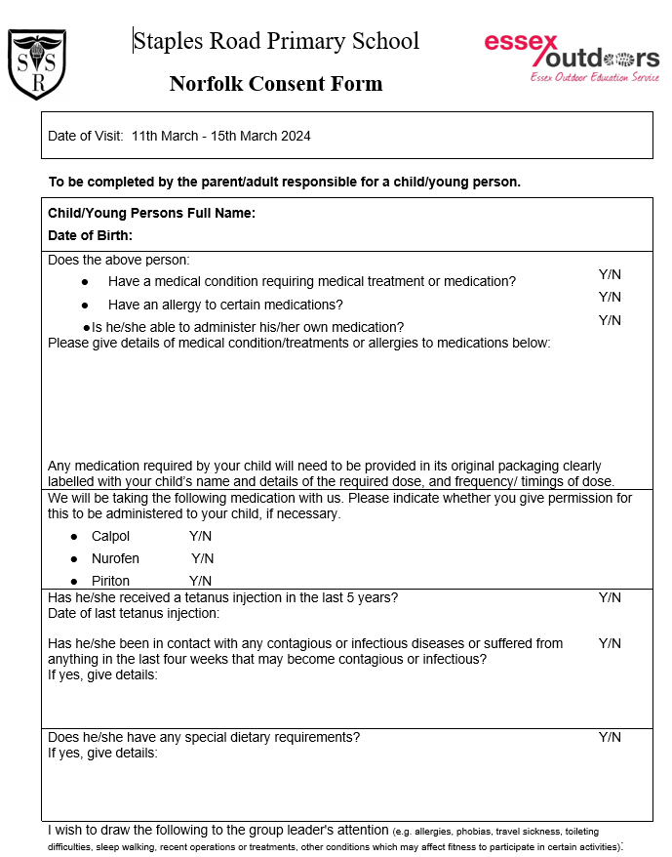
Medical declaration & consent
We will request one of these from you much nearer to time.
Notes:
Lindsey – medical forms – collection of medication prior to departure

Slide 16

Costs
Approx £500 per child
All-inclusive (except for a small amount of pocket money)
Deposit before end of term (July)
Staggered payments
Notes:
Lindsey – medical forms – collection of medication prior to departure

Slide 17
Recent comments
It was great being able to spend lots of time with all my friends and sleep over! - Evelina Hubke (Oak Class)
The trip was full of exciting activities that everyone enjoyed! I really enjoyed the trips out each day and the dinners were really tasty – George Marsden (Oak Class)
I loved the scavenger hunt on the beach and looking for fossils. My favourite bit was getting to drive the boat but also the night-time walk, especially as we got hot chocolate! – James Hansen (Oak)
All amazing. Excellent all week – Kibworth Primary School
Everything was perfect...staff with the skills to bring learning to life – Colne Engaine Primary School
What an experience! Every child achieved something incredible – Burwell Primary School
The food is amazing and everyone has been friendly and welcoming – Thordon/Mellis/Eye/Occold Primaries
A fantastic week with lots of WOW moments! – Aveley Primary School

