Slide 1


School Journey
16th - 20th June 2025
AYLMERTON
North Norfolk

Slide 2
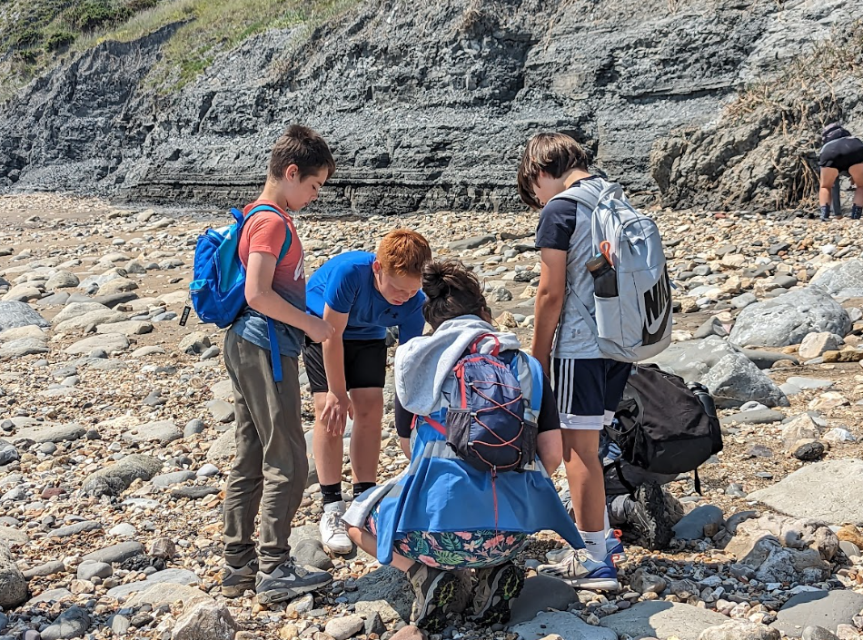
School Journey - rationale
“Learning outside the classroom is not some optional extra… Residential and educational school Trips and getting out of the classroom should be part and parcel of school life”- Ed Balls (then Education Secretary)
Health benefits
Self-esteem
Independence
Team building
Balance
Notes:
Nick – introduction and rationale

Slide 3
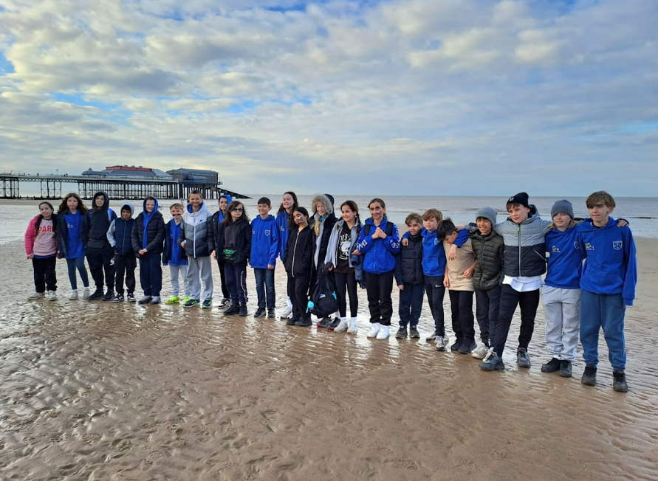
From Lambourne End to Aylmerton
Differences:
Year 6 School Journey is a 4-night residential
Coach travel to and from Norfolk
Dormitory accommodation not tents
Similarities:
Staples Road staff
Activity programme
Notes:
Nick – introduction and rationale

Slide 4
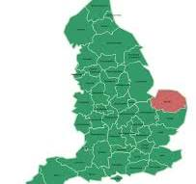
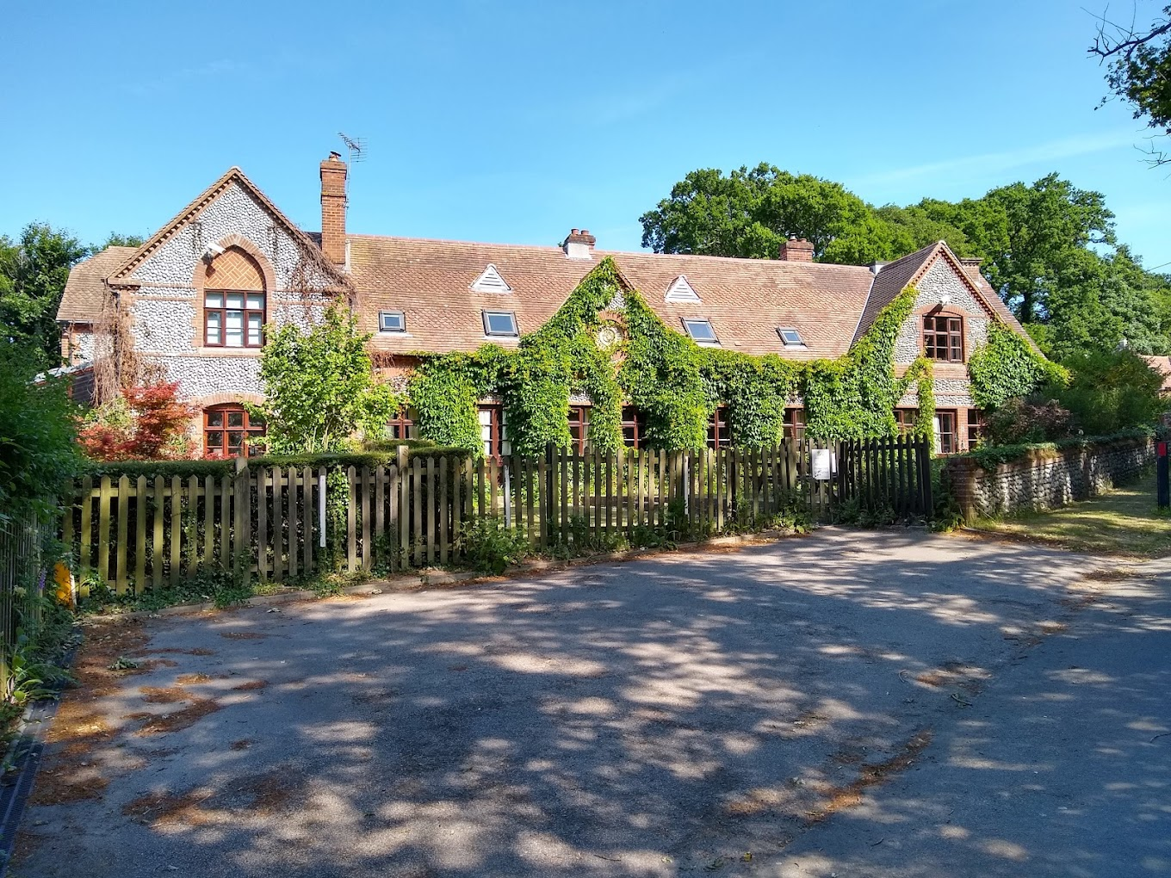
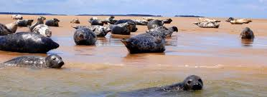
Aylmerton (Norfolk)
Notes:
Nick – risk assessment process

Slide 5
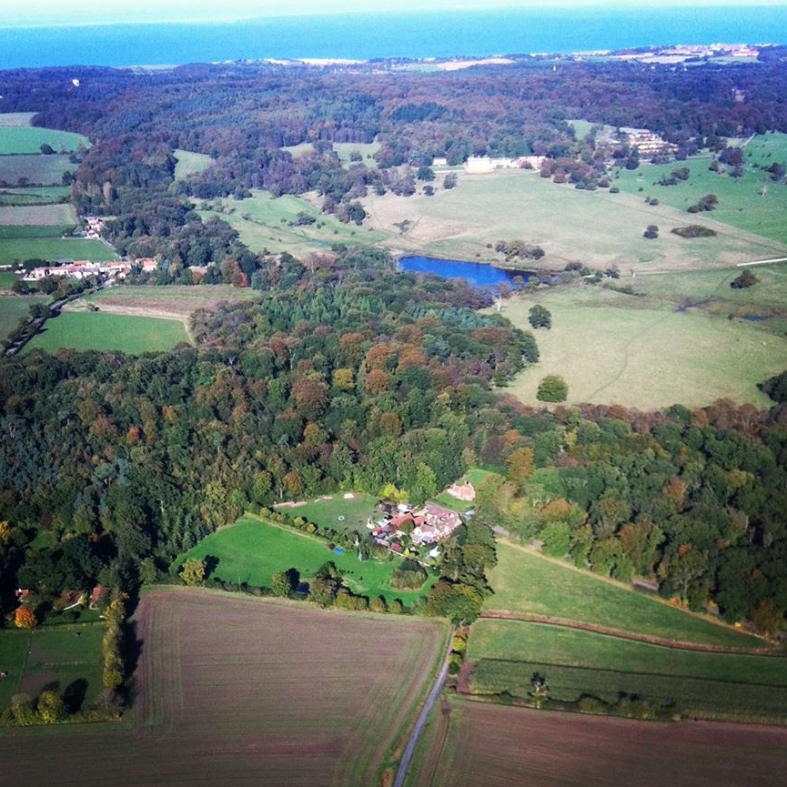

Aylmerton
Situated 4 miles from the North Norfolk coast

Slide 6
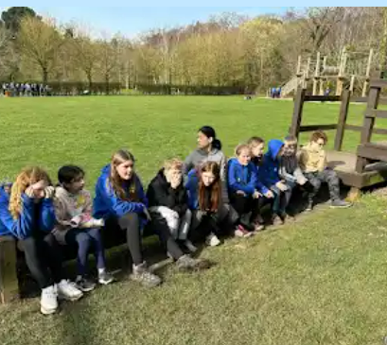
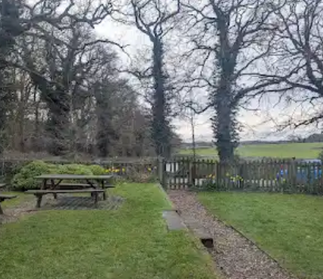

Aylmerton
The grounds

Slide 7
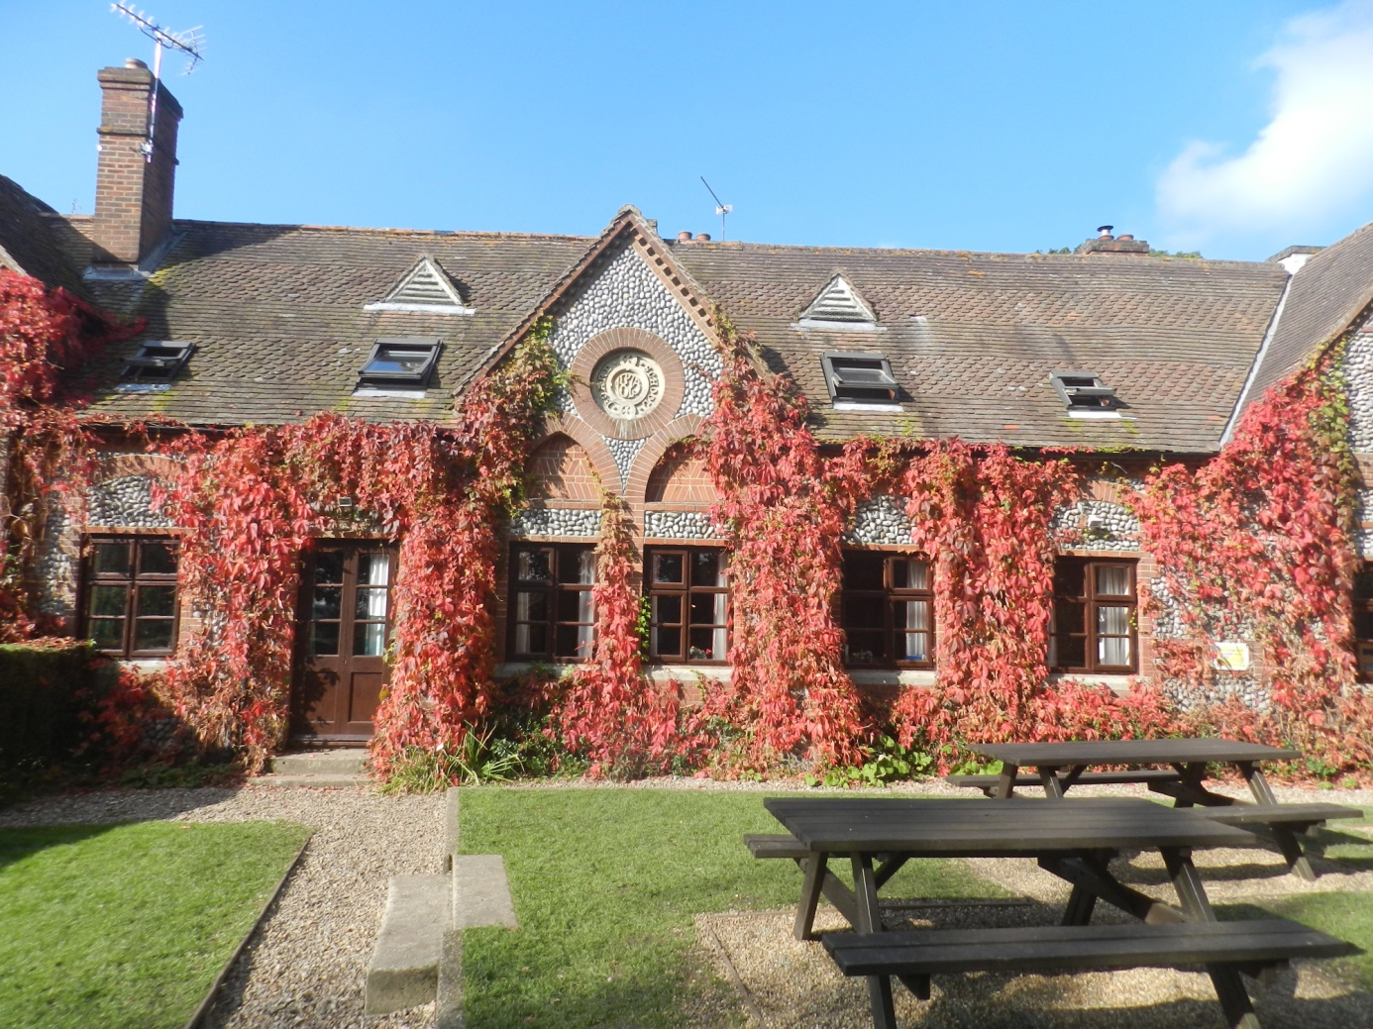
Safety & Staffing
Full risk assessment completed (April 2025)
Local Authority (Essex) checked and approved
Trained and qualified activity leaders at Aylmerton – all with CRB
35 years experience
Notes:
Nick – risk assessment process

Slide 8
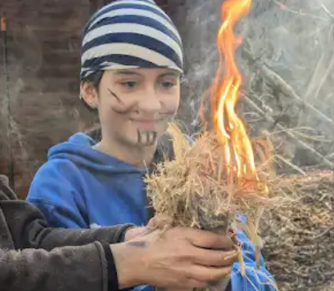
FAQs – How safe is my child?
Regular external inspections – outdoor equipment, gas, electrical appliances, food hygiene, trees, safeguarding (all staff DBS checked)
Approved suppliers – e.g. Ferries and coaches
Permanent staff
Thorough training of all staff
All staff first aid trained
Staff carry two way radios and mobile phones off-site
Safety equipment – ‘above and beyond’ – lifejackets, two way radios, throw lines

Slide 9
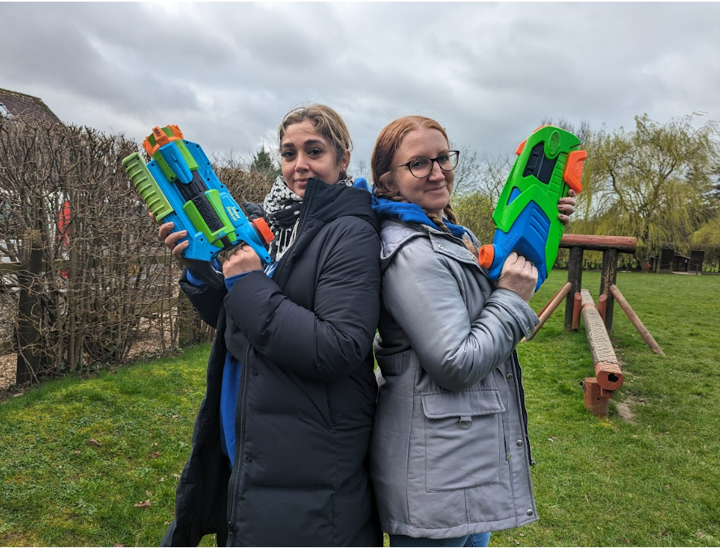
Safety & Staffing
10 SRS staff split evenly between coaches
Minimum 2 trained First Aiders
Minimun 2 Senior Leaders
Notes:
Nick – staffing (subject to change in terms of names)

