Slide 1
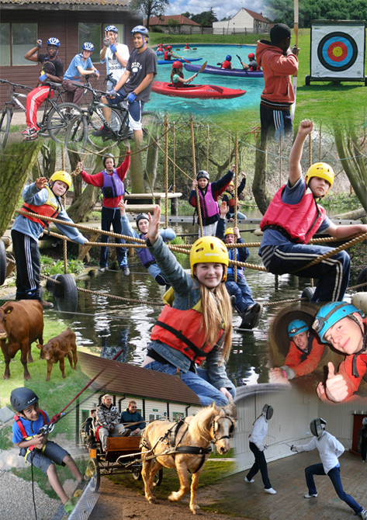

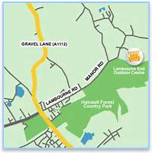
Year 5
Overnight Residential
to Lambourne End
We are not far away… but far enough!

Slide 2

LAMBOURNE END
Year 5
Wednesday 25th and Thursday 26th May 2022

Slide 3
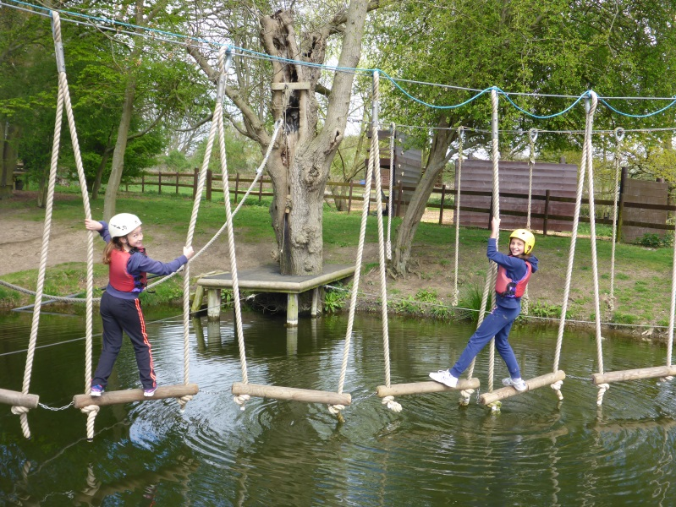
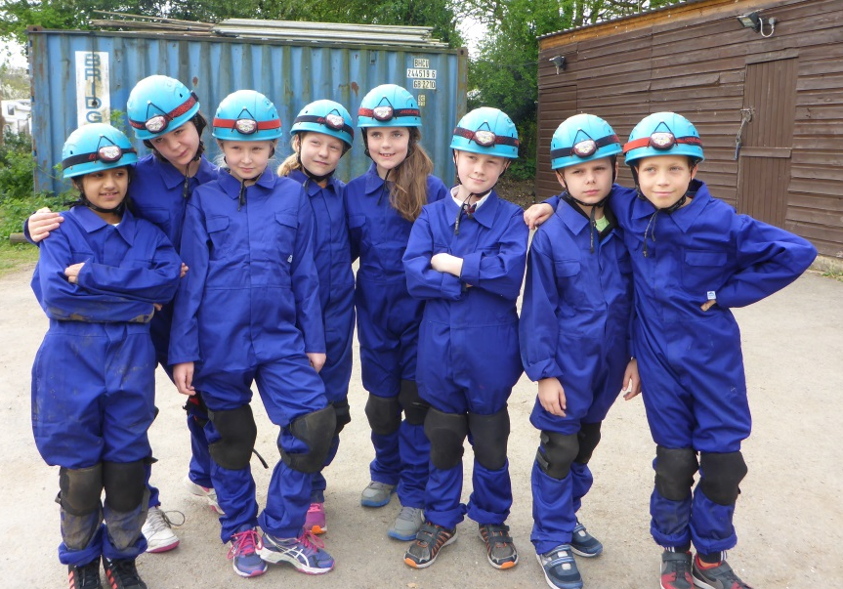
Why are we going?
Independence
Confidence
Look after themselves
Night away
Team work
Outdoor Activities
Rounded Education
Fun

Slide 4
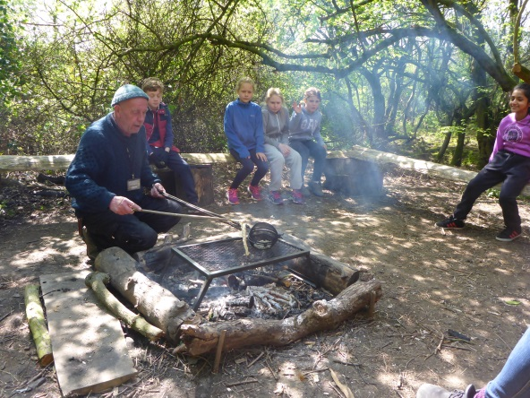
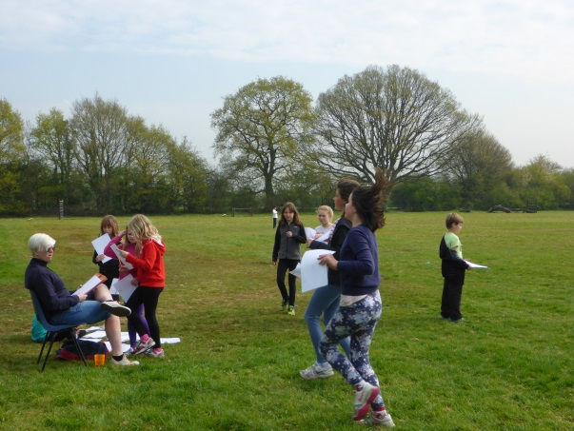
Timetable Day One
Meet at Lambourne End between 9.00 and 9.30am
Meet teachers & leaders and settle into tents
Activity
Lunchtime (Packed Lunch)
Activity
Break
Activity
Break
Activity
Dinner
Organised free-time (teachers to supervise)
Walk in grounds (teachers to supervise)
Circle time
Bed-time 9.30pm
Bush Skills
Orienteering

Slide 5
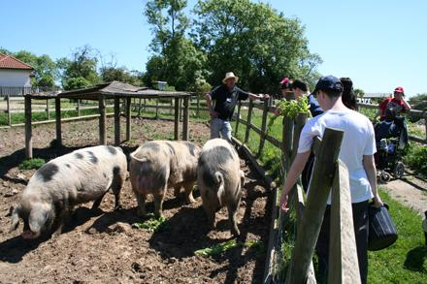
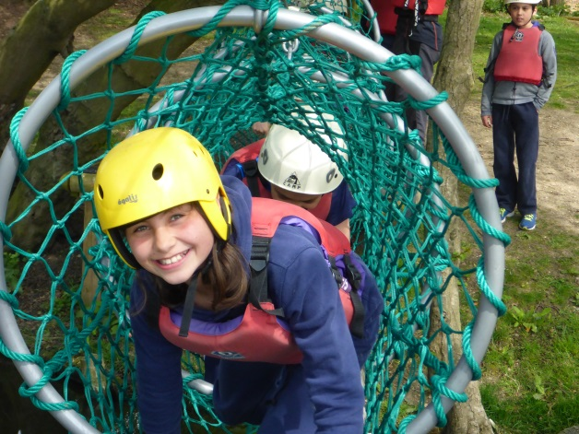
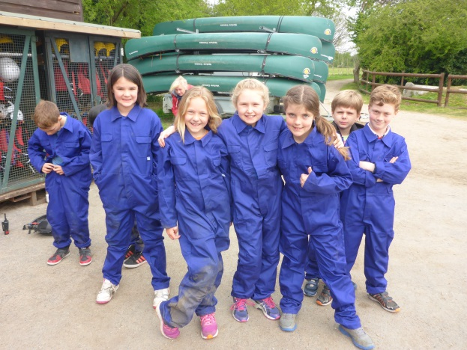
Timetable Day Two
Wake up 7am
Breakfast
Activity
Break
Activity
Lunchtime
Activity
Break
Activity
Tidy Tents
Collection by parents/carers 4.30pm prompt
Farm Visit
Low ropes course
Caving

Slide 6
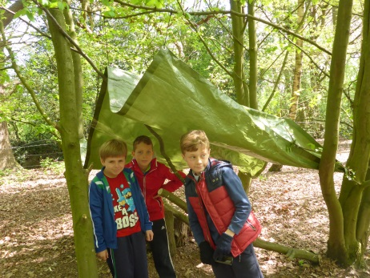
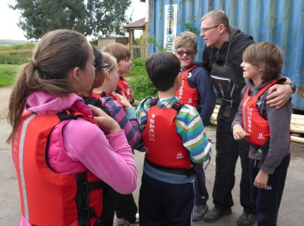
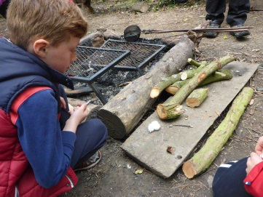
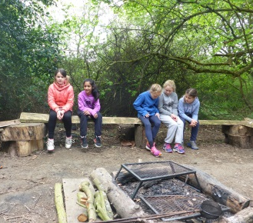
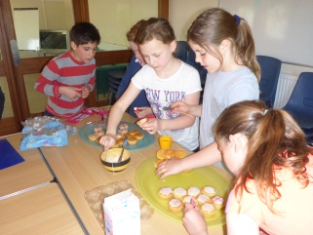
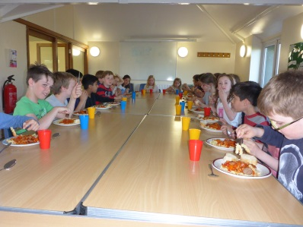
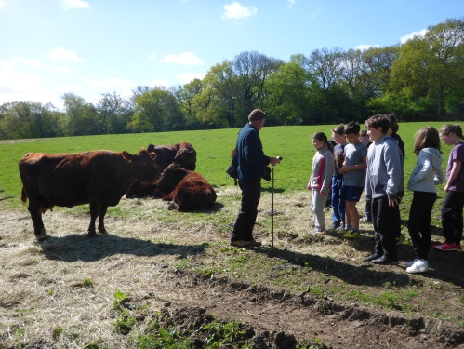
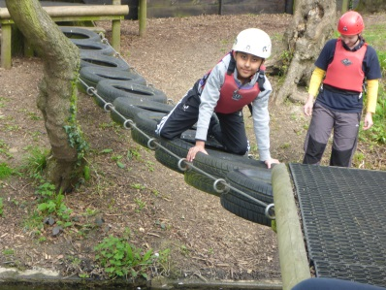
Activities
Activities led by Lambourne End Staff
Ropes Course
Raft Building
Climbing
Archery
Farm Tour
Bushcraft
Orienteering
Trim Trail
  Appropriate safety equipment is provided
  e.g. helmet, overalls and life buoyancy vest

Slide 7
Activities
Other Activities led by Staples Road Staff
Forest Walk
Preparing breakfast and lunch
Circle Time
Bedtime

Slide 8
What does my child need to bring…
Children should be dropped off at Lambourne End wearing appropriate clothing for a day of outdoor fun and old trainers, please.
Long sleeves and trousers are best for some of the caving and climbing activites.
ALL CLOTHES MAY GET MUDDY AND WET
They should also bring:
Sleeping bag, thin ground mat and pillow case (Sheet and pillow provided)
Pyjamas
Full change of clothes including underwear and socks - 4 or 5 changes of clothes (raft / ropes /dry)
2 pairs of old shoes (Wellies with name inside in a plastic bag if the weather has been particularly bad)
Large towel and washbag
Waterproof jacket
Torch
Black bin liner for dirty & wet clothes
Teddy bear
Lunch for first day and snack
All clothes are to be packed in a soft holdall / rucksack please
PLEASE ENSURE ALL CLOTHING IS LABELLED WITH YOUR CHILD’S NAME
NO ELECTRONIC EQUIPMENT OR ANY OTHER VALUABLES PLEASE

Slide 9
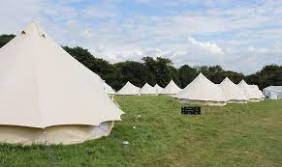
ACCOMMODATION
Bell tents (sleep up to 8)
Situated near the lodge and toilets / showers and kitchen.
SRPS adults in adjacent tents.
The children will not be told their rooms until nearer the time – they will of course have friends in with them, so please don’t let them or you worry!

Slide 10
FOOD
Dinner – pizza van
Breakfast – cereals and fruit
Lunch – rolls /crisps and snack and fruit
ALLERGIES
The children will not be told their rooms until nearer the time – they will of course have friends in with them, so please don’t let them or you worry!

Slide 11
What do we need from you?
School Journey Form (medical) Completed
  Note any individual concerns on the back of the form or arrange to speak with your child’s teacher
Outstanding Balance to pay
First Day
  Child appropriately dressed and bag packed (kit list only)
  Any medication in a sealed named bag handed to first aider
Provide a Packed Lunch and named full water bottle
Second Day
  Collect your child from Lambourne End at 4.30pm prompt
  ANY QUESTIONS?

